Slide 1
HOME AUTOMATION
BY-Deepak Kumar
Roll no.-1901CS18
Branch-CSE
CS225-CS226 PROJECT

Slide 2
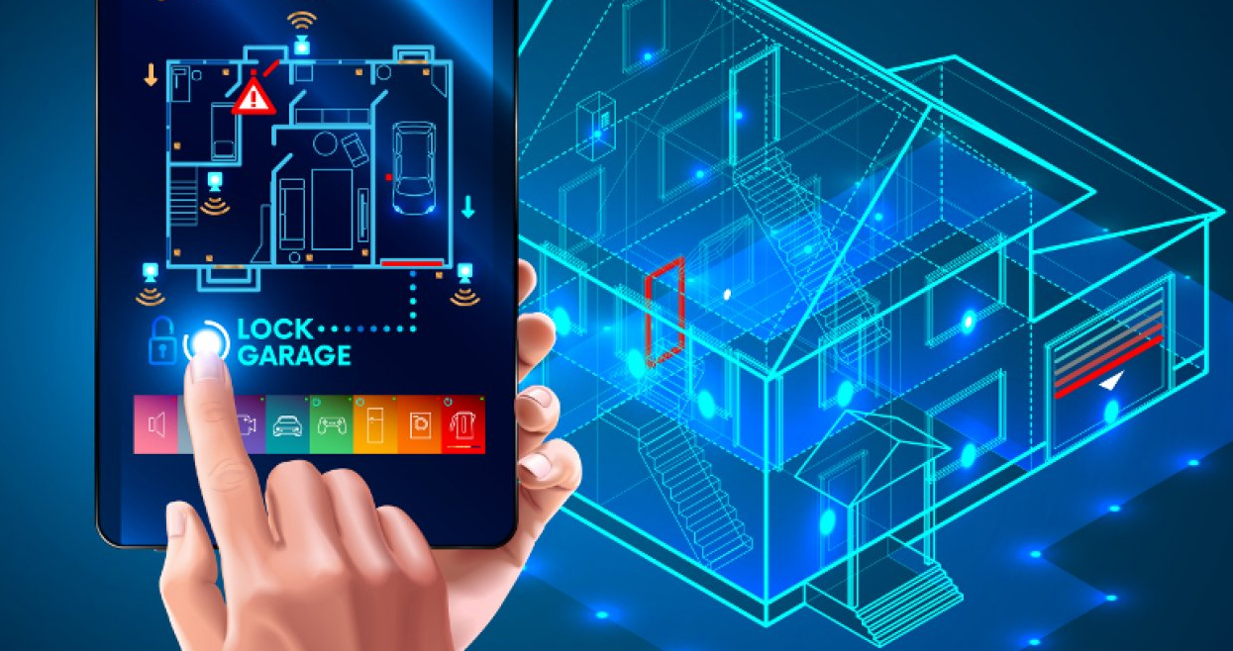
WHAT IS HOME AUTOMATION
Home automation or domestics is building automation for a home, called a smart home or smart house. A home automation system will monitor and/or control home attributes such as lighting, climate, entertainment systems, and appliances. It may also include home security such as access control and alarm systems. Home appliances are excess by android phone,remote control,without changing the home infrastructure. Home automation has high potential for sharing data between family members or trusted individuals for personal security and could lead to energy saving measures with a positive environmental impact in the future.

Slide 3
WHY HOME AUTOMATION?
1.Save time
2.Self maintainance
3.Security
4.Make life easy
.IN MY PROJECT:-Equipment list
1.Arduino
2.5v 4 channel relay module
3.Hc-05 Bluetooth module
4.Mobile phone application(1.app voice control home automation,2.Home automation using switch button)
.Project working function:-In this project using above equipment I made home automation project,in this I use two app 1st app is use to control appliances use voice control and 2nd app use to control by button.

Slide 4
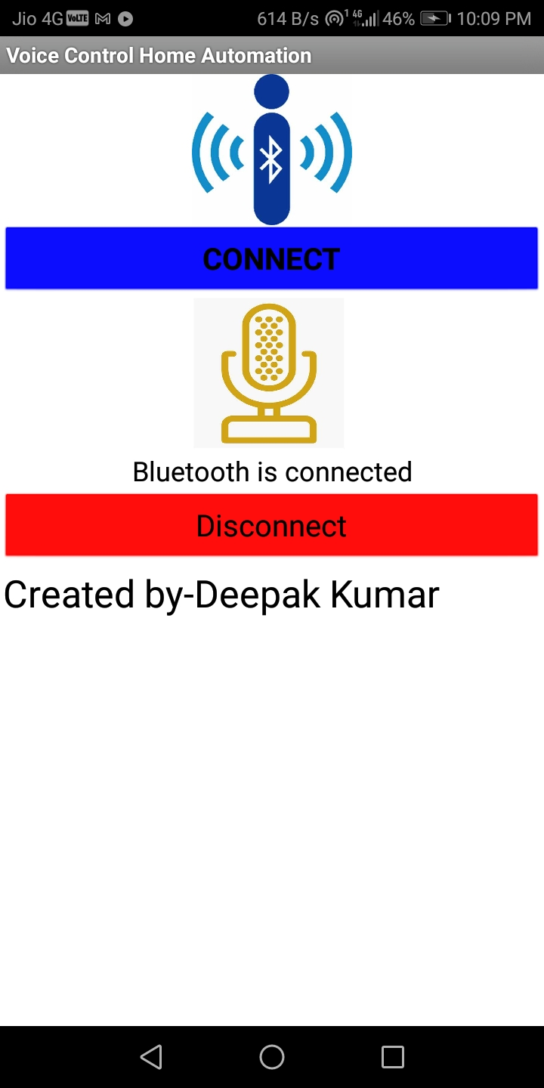
SYSTEM SOFTWARE PART DESIGN
1.HA is a system which is control by a mobile phone using mit app inventer2 .
2.Arduino code is also used to control HA project.
For voice control app has command is use to control appliances:-
1.turn on all device
2. turn off all device
3.Light on
4.Light off
5.mobile charging on
6.Mobile charging off
7.Fan on
8.Fan off
9.Last relay on
10.Last relay off

Slide 5
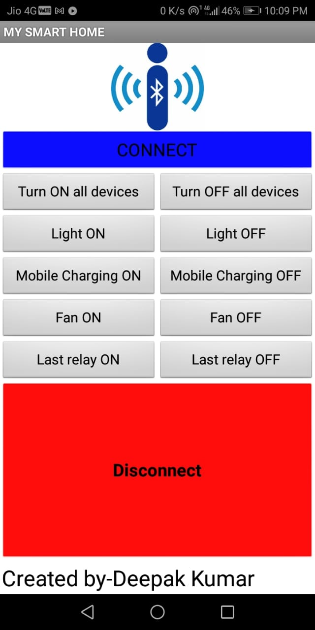
SYSTEM SOFTWARE PART DESIGN
2nd app is use using button control:-

Slide 6
SYSTEM DATA FLOW
Server(mobile phone controlling device application)
Bluetooth application
Via bluetooth
Serial monitor
(Arduino)
Devices
Relay module
(switching circuit)

Slide 7
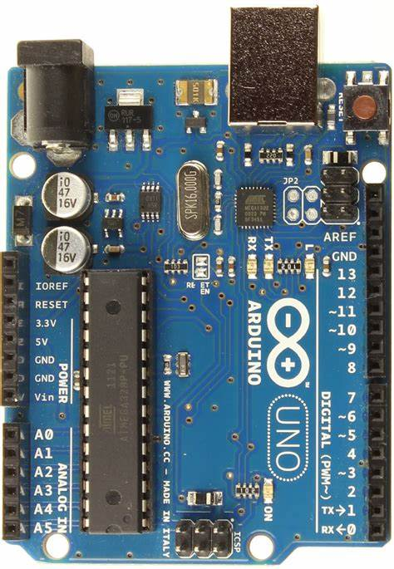
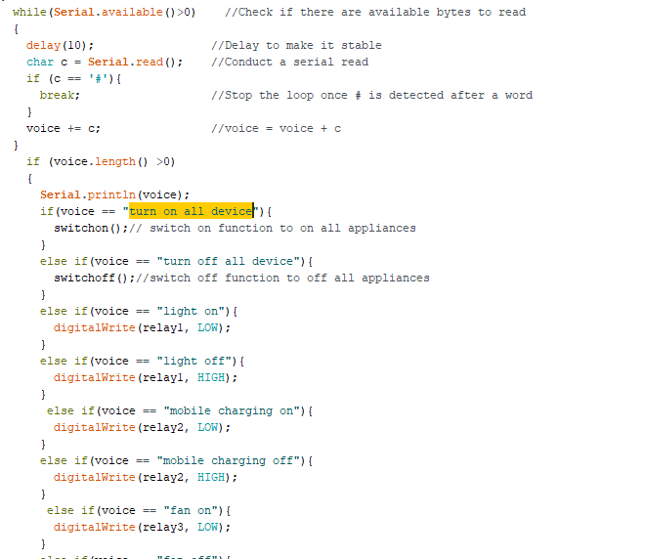
ARDUINO BOARD
ARDUINO:-it is an open source physical computing platform for creating iterative object that stand alone or Collaborate with software on your computer. Arduino was designed for artist ,designer and other who want to incorporate physical computing into their design.
Arduino means three things :
A piece of hardware
A programming environment
Arduino ide

Slide 8
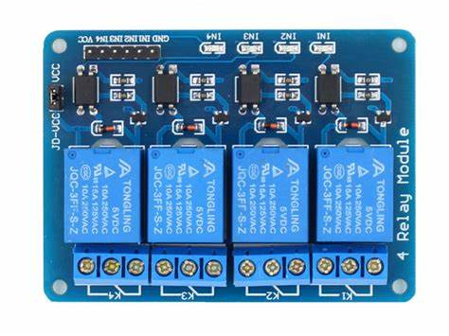
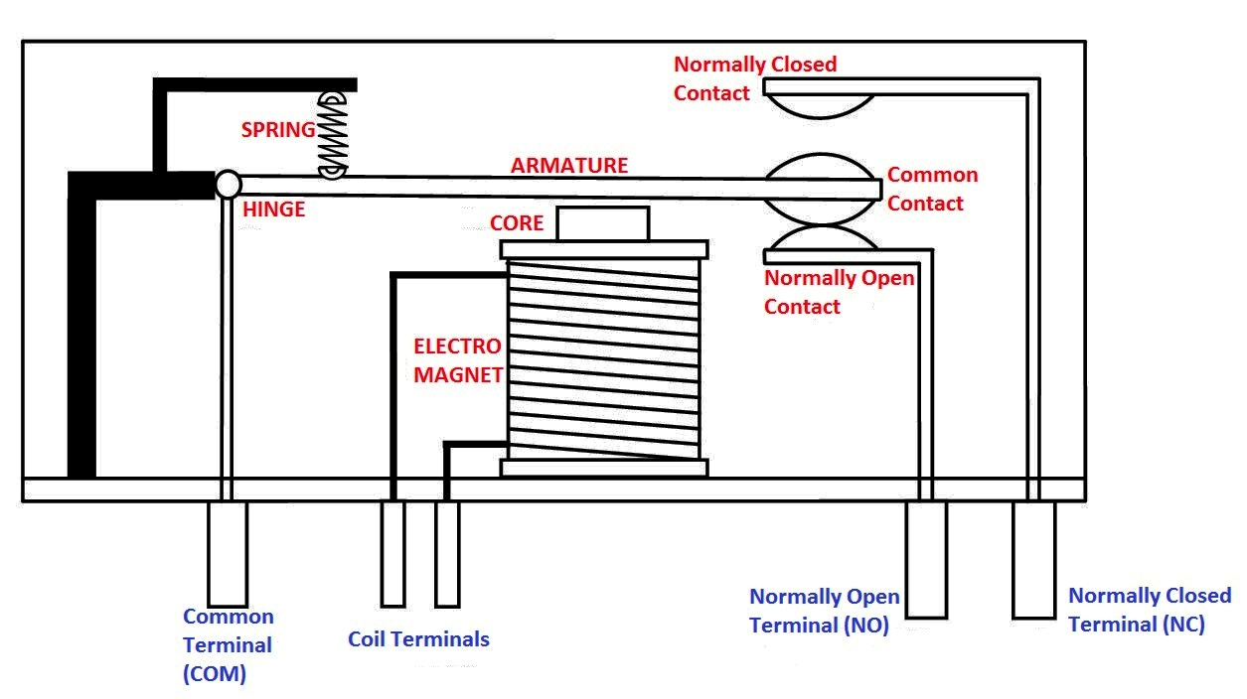
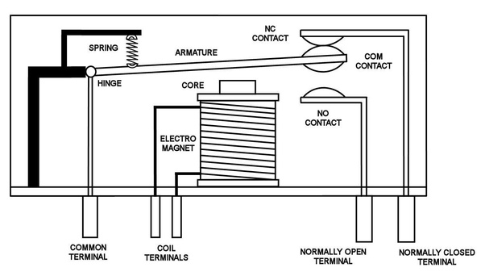
RELAY
A relay is an electrically operated switch. It consists of a common terminal ,Directly open and directly closed terminal.
It is act as switch.

Slide 9
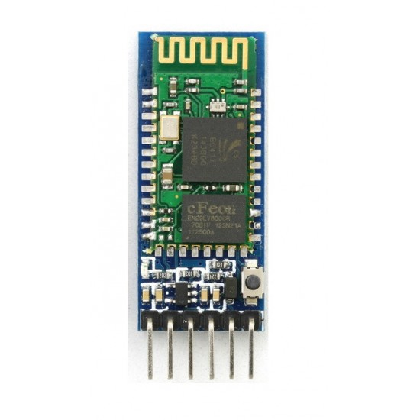
BLUETOOTH MODULE HC-05
HC-05 module is an easy to use Bluetooth SPP (Serial Port Protocol) module, designed for transparent wireless serial connection setup.
This is trans receiver hc-05 breakout is the latest Bluetooth wireless serial cable.

Slide 10
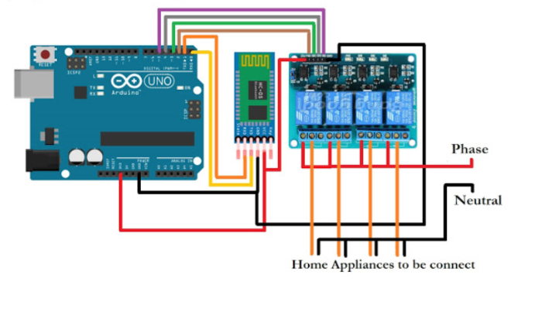
AIM CONCLUSION CIRCUIT DIAGRAM
AIM:-
The basic aim of Home automation is to control or monitor signals from different appliances, or basic services. A smart phone or web browser can be used to control or monitor the home automation system.
Conclusion:-
Home Automation is undeniably a resource which can make a home environment automated. People can control their electrical devices via these Home Automation devices and set up controlling actions through Mobile. In future this product may have high potential for marketing.

